Slide 1
Effects of Smoking on Gene Expression in South Korean Patients with Lung Adenocarcinomas
Jess White
ANGSD 2020
April 14, 2020

Slide 2
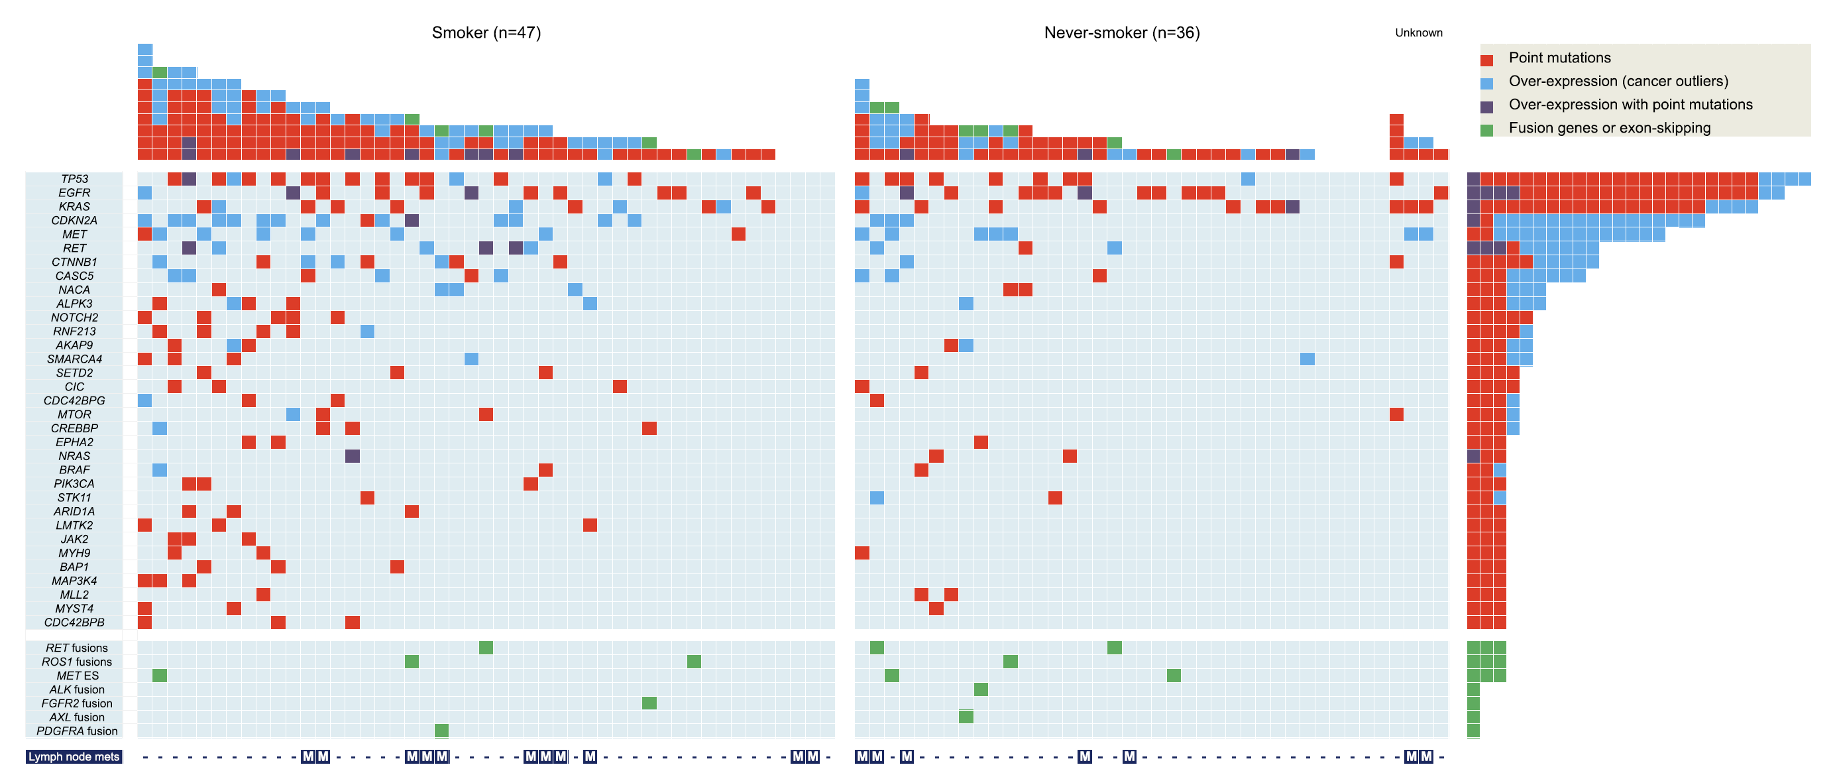
Lung adenocarcinomas of smokers are associated with a distinct genetic signature and higher mutational burden
Source: Seo et al., Genome Research, 2012.

Slide 3
Paired-normal samples aligned at a higher rate than tumor biopsies, but tumor biopsies expressed more unique genes

Slide 4
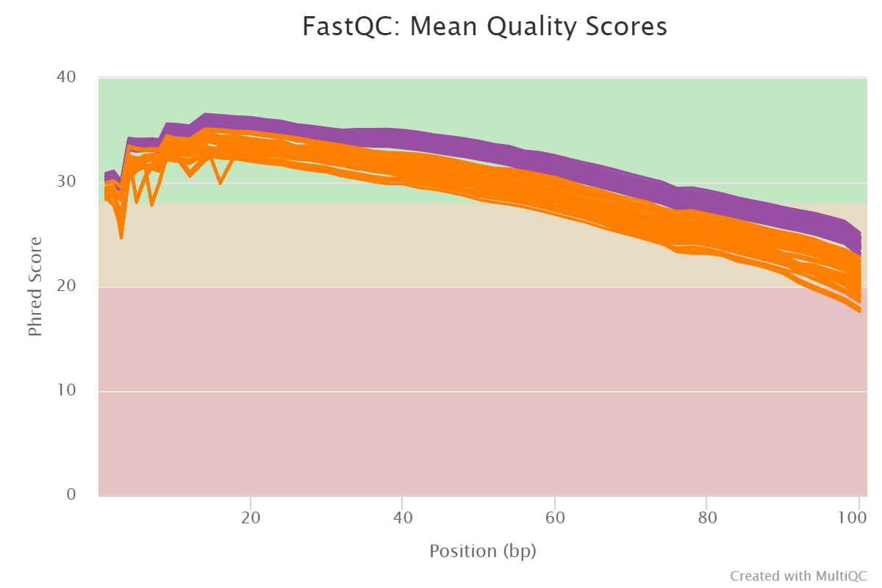
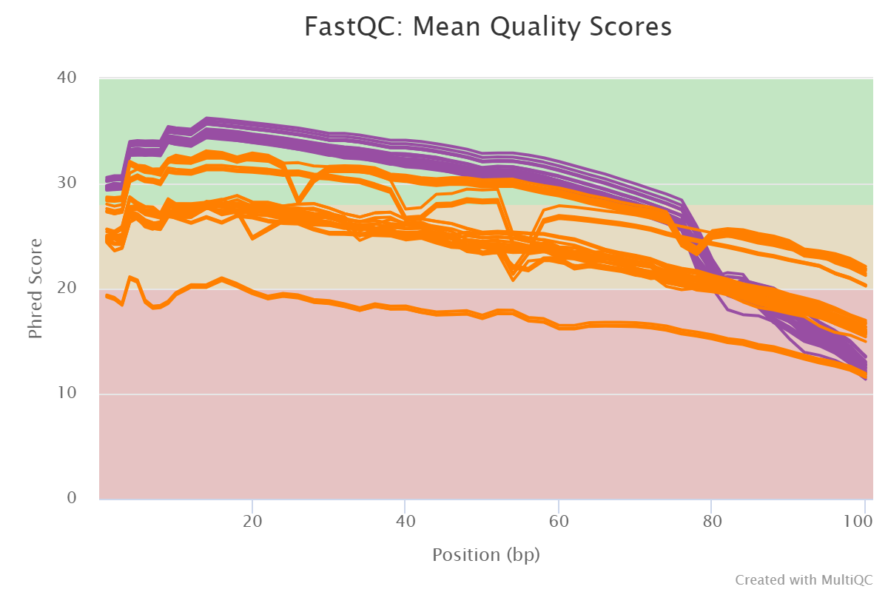
Phred scores were worse for tumor biopsies and demonstrably worse for paired-end read 2 than paired-end read 1
Paired-End Read 1
Paired-End Read 2

Slide 5
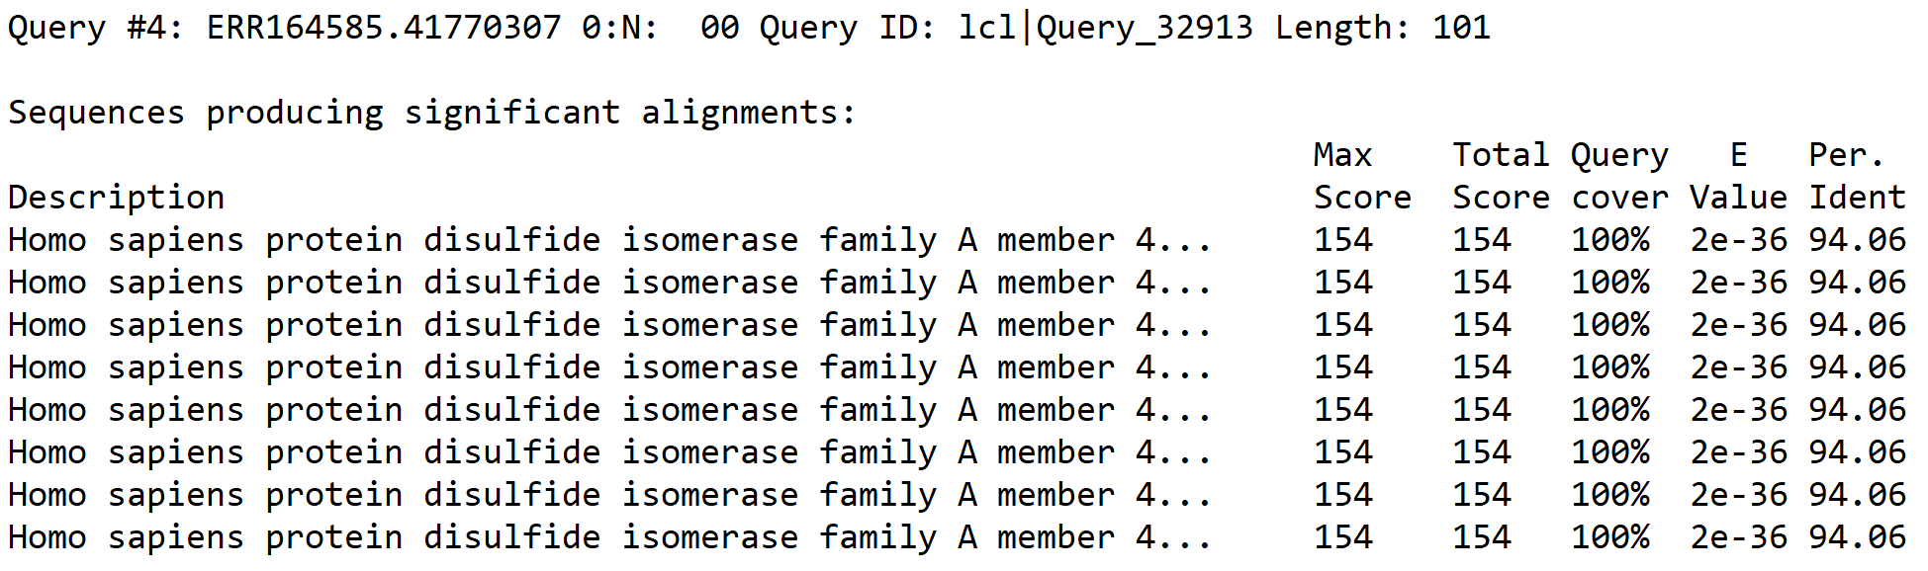
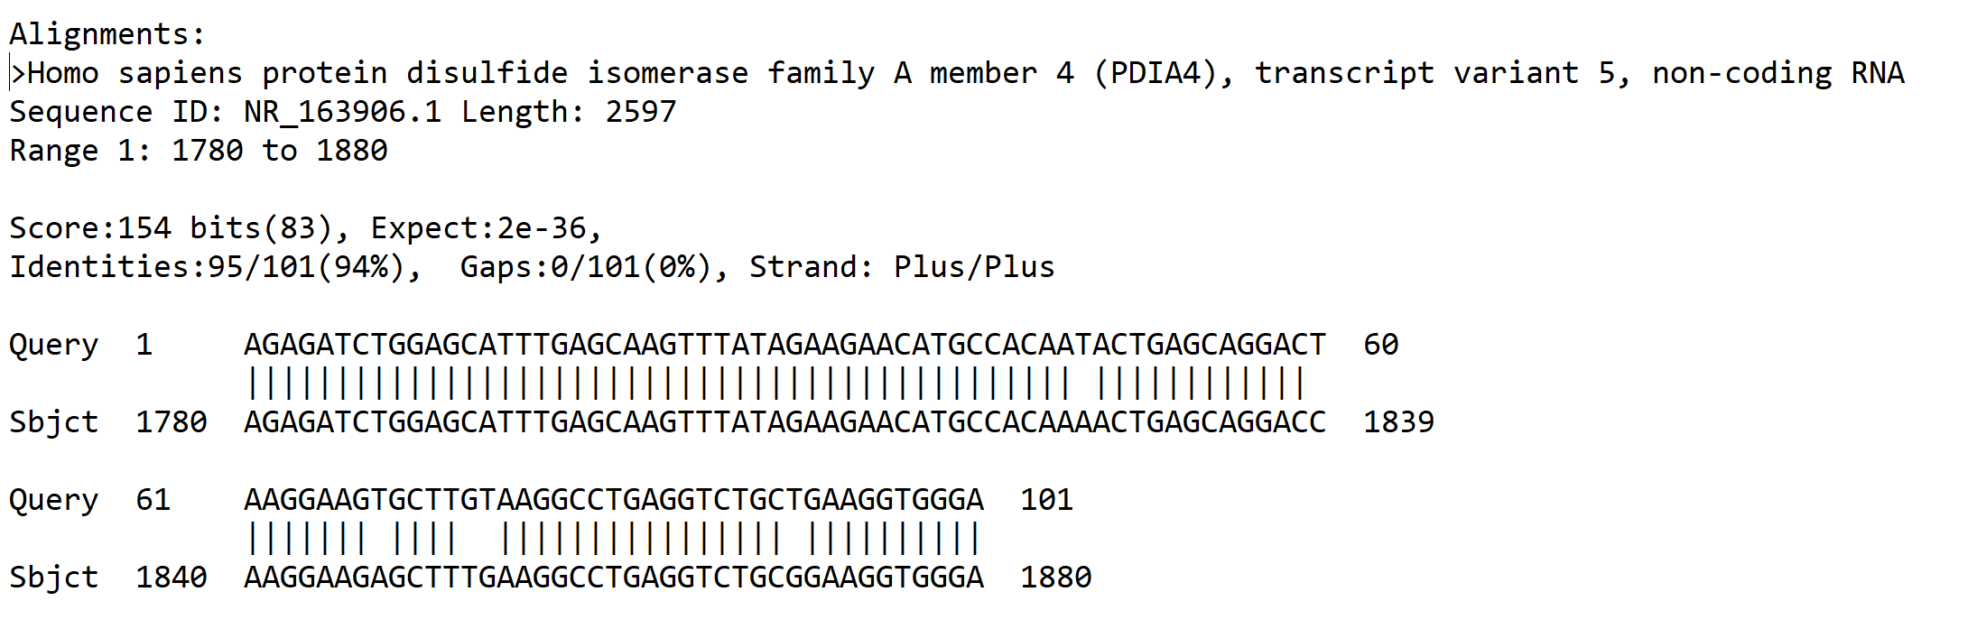
BLAST alignment of small subset unmapped cancer sample reads suggests tumor mutational burden complicates mapping

Slide 6
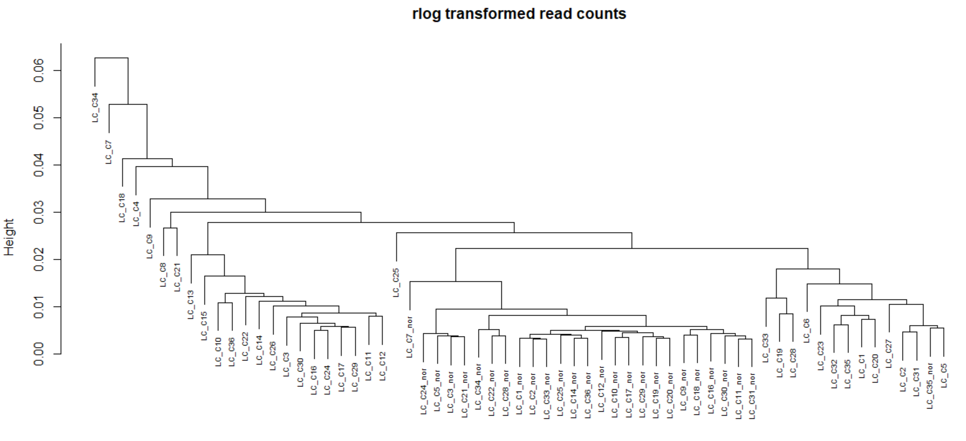
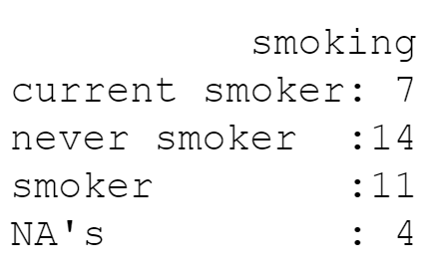
Hierarchical clustering reveals distinct normal cluster and suggests smoking and non-smoking clusters may be distinct

Slide 7



Many of the most differentially expressed genes were pseudo- genes or lncRNA, but some were known lung cancer targets

